Slide 1
Feynman Robot
(Black Hexapod)
Project 1
Meshal Albaiz, Tristan Cunderla, Brian Henson, Aron Schwartz
Notes:
Meshal

Slide 2
Verified the functionality of all components previously implemented.
Tested the servo motors for complete functionality.
Tested the functionality of the Raspberry Pi and servo HAT.
Tested the functionality and reliability of the power supply.
Tested the functionality of the movement software.
Tested the functionality of the Pi Camera (not operable).
Tested the functionality of the vision/object detection software.
Tested the functionality of the torso.
Installed all necessary updates, libraries, and packages.
Notes:
Meshal

Slide 3
Angel vs. Demon Quantum Controlled Game
Played on a 2D grid, bomb and robot positions are determined.
Demon tries to detonate bomb, Angel tries to avoid it.
Player can tell Demon to move right or move up to the right.
Player can tell Angel to move up or make no move.
Robot either obeys command or disobeys it based on combination of light levels and quantum circuit output.
Demon wins by “detonating” to the bomb.
Angel wins by going past the bomb in either the x or y direction.
Notes:
Game description and outline - Meshal

Slide 4
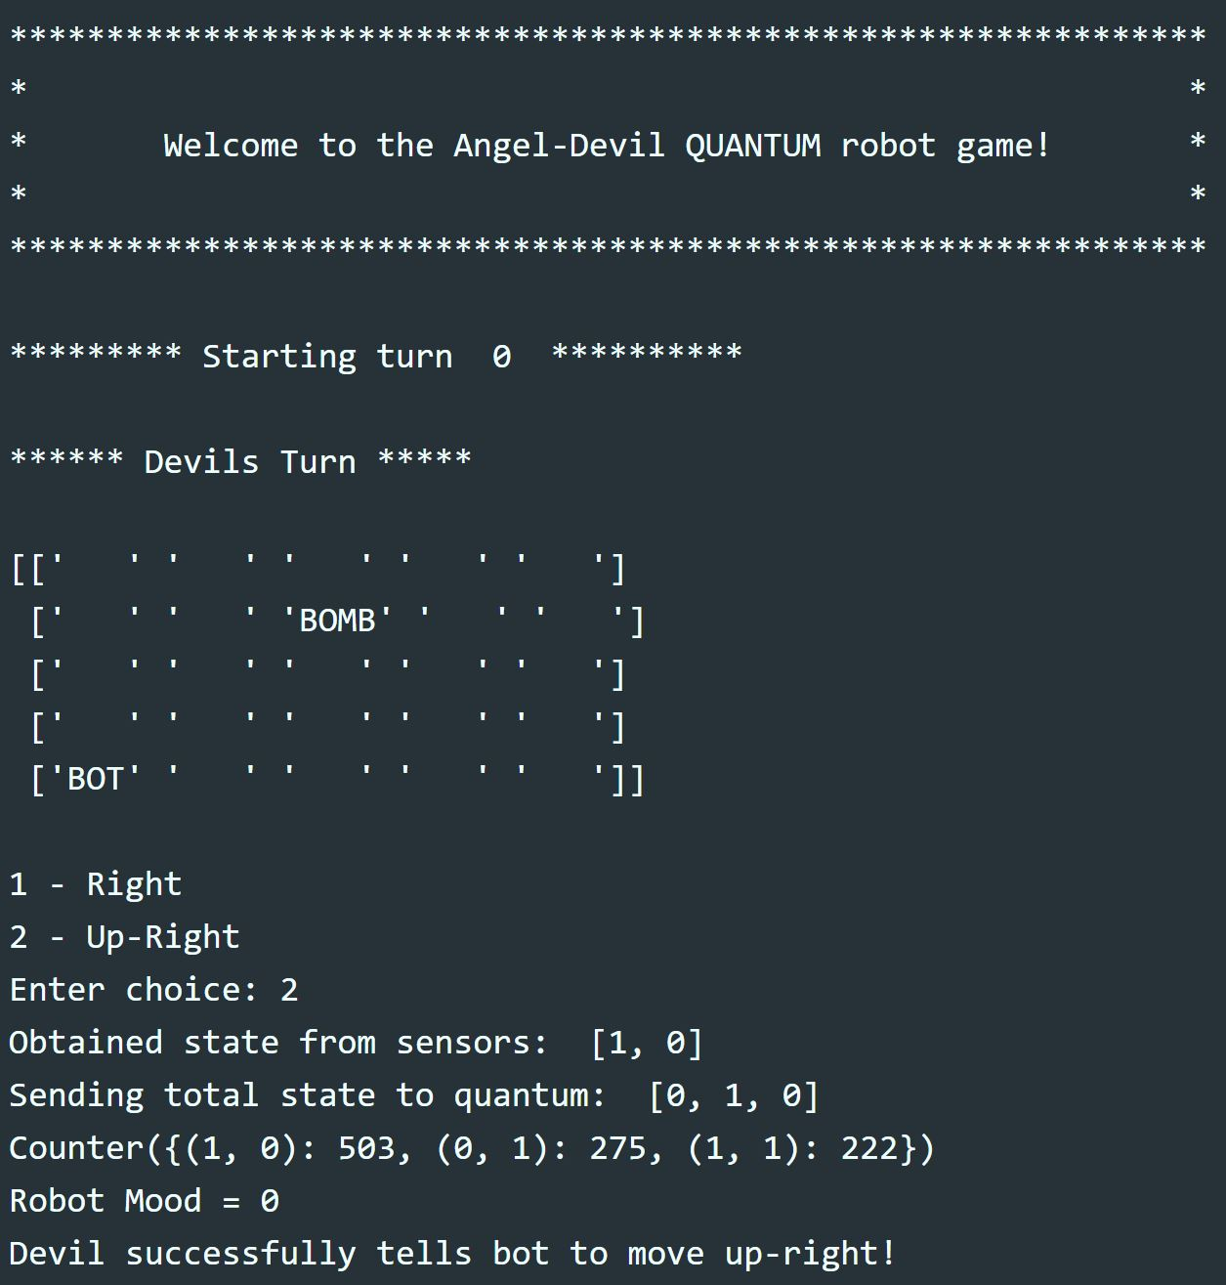
Game Logic and Virtual Map
Physical grid is tracked with identical “Virtual Grid”
Game position variables tracked and handled
Bot/Bomb Initial Position
Game Grid Shape
Move destination checked in virtual grid to determine corresponding behavior
Devil Victory/Angel Victory and associated “dance”
“Null game” detection, prevent out of bounds
Player Turn and Light Levels passed as common vector to quantum module
3 bit vector: [TURN_BIT, LIGHT_BIT_1, LIGHT_BIT_2]
Move “code” returned and interpreted as “obey”, “neutral disobey”, or “malicious disobey”
Notes:
Aron - About the game code Aron wrote

Slide 5

Using Webcam to Determine Brightness
Brightness value determined with OpenCV and webcam
Camera captures image and converts to grayscale
Grayscale image is divided into 15 sections and the average brightness for each section is calculated
Minimum and maximum brightness values are discarded and the average of the remaining sections is calculated
Average value is used to indicate which light zone the robot resides in
Darker zones favor the devil and lighter zones favor the angel
Light Zone | Brightness Values | Q₀ | Q₁
Dark | 0 - 99 | 0 | 0
Slightly Dark | 100 -125 | 0 | 1
Slightly Light | 126 - 152 | 1 | 0
Light | 153 - 255 | 1 | 1
Notes:
Tristan

Slide 6

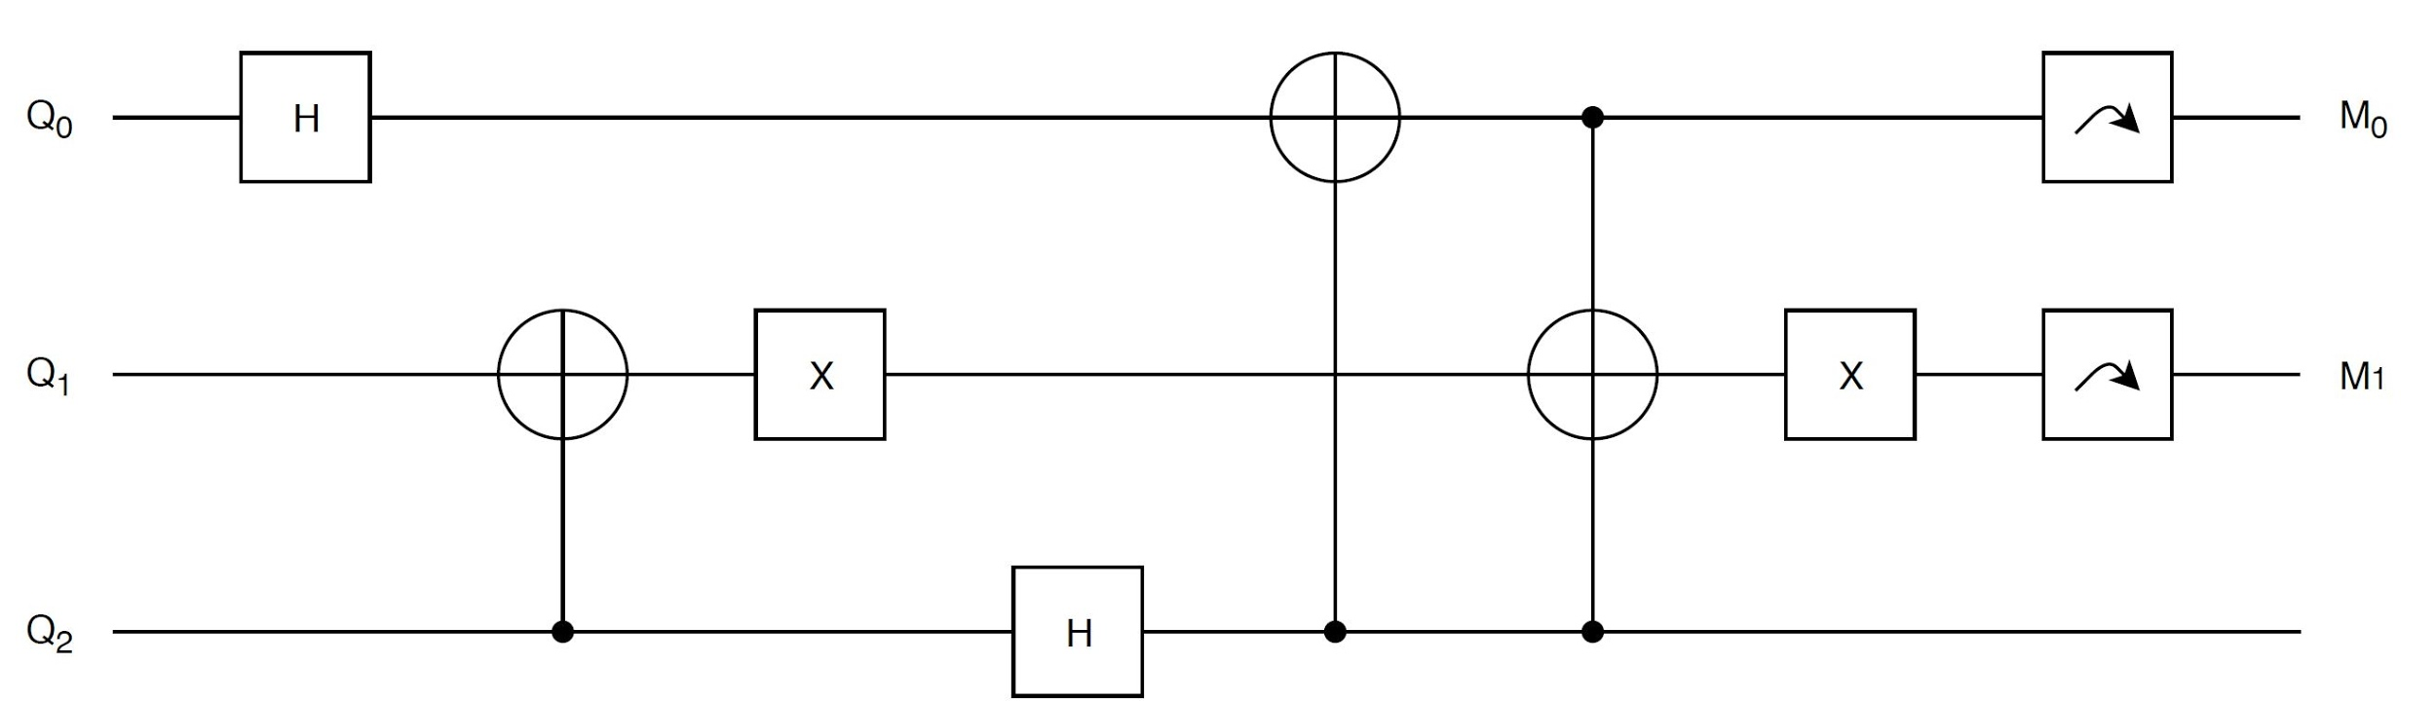
Decision Making Using Quantum Circuit
Circuit built and tested using IBM’s Quantum Experience online resource
Circuit implemented in Python using Google’s Cirq library
Quantum circuit is composed of Hadamard, CNOT, Pauli X and Toffoli gates
Three input bits correspond to current player and the light zone the robot is current in
A measurement is done on Q₀ and Q₁ to determine the robot’s “mood”
Circuit is ran 1000 times to determine counts
Mood output is chosen from counts at random
Output Value | Robot “Mood”
00/11 | Obey
01 | Neutral
10 | Disobey
Notes:
Tristan - talk about why we chose cirq over other libraries

Slide 7
Driver Updates: Interpolation & Threading
Problem: existing motion was jerky and “robotic”
Pose-based animation system
Servos do not support any speed control: move to & hold
Solution: interpolation & RTOS-inspired multithreading!
Main thread: pose transition broken into “frames”, added to queue
Background thread: consumes frames to actually set position
+ Less shaking, more linear motion
+ More lifelike for robot theater
+ Easy speed control
+ No more blocking-wait, allow parallel processing (eventually)
Notes:
Brian - Notes: mention that it is python threading, no priority guarantees, thread-safe changes, one thread per leg, higher-level drivers not yet updated

Slide 8
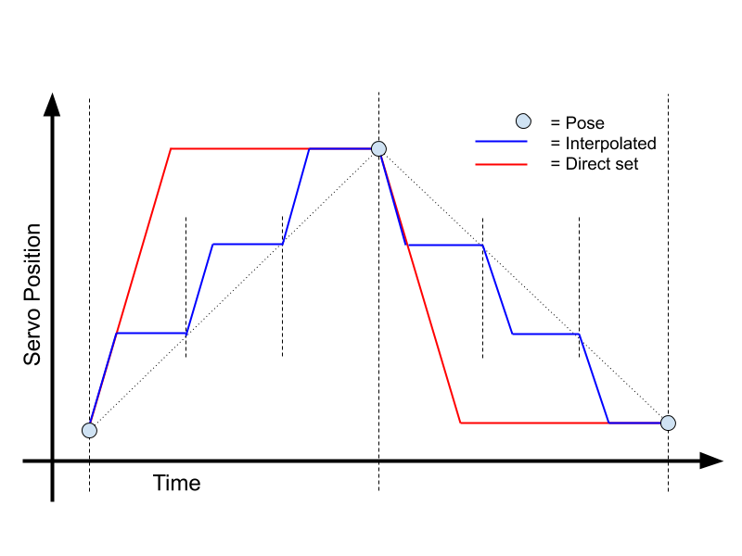
Driver Updates: Interpolation & Threading
Notes:
Brian - Notes: mention that the **slope is the same** during motion in both methods

Slide 9
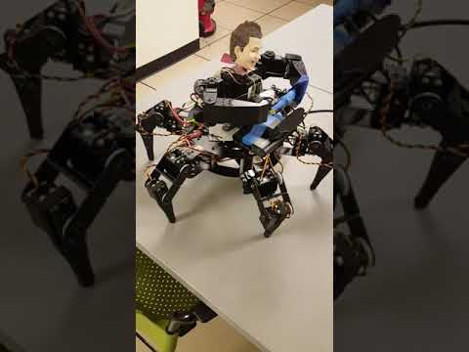
Driver Updates: Interpolation & Threading
Notes:
Brian - 24 sec video

Slide 10
Demo 1 - Angel Wins
Notes:
Meshal - talk through demo 1

Slide 11
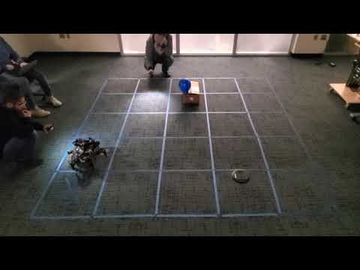
Move 1 - Devil Move

Slide 12
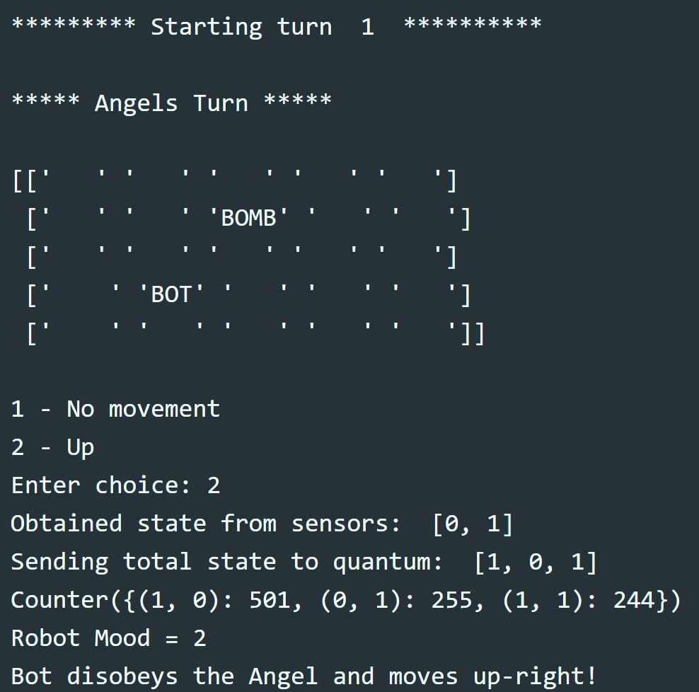
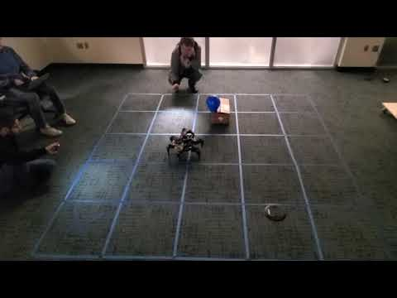
Move 2 - Angel Move

Slide 13
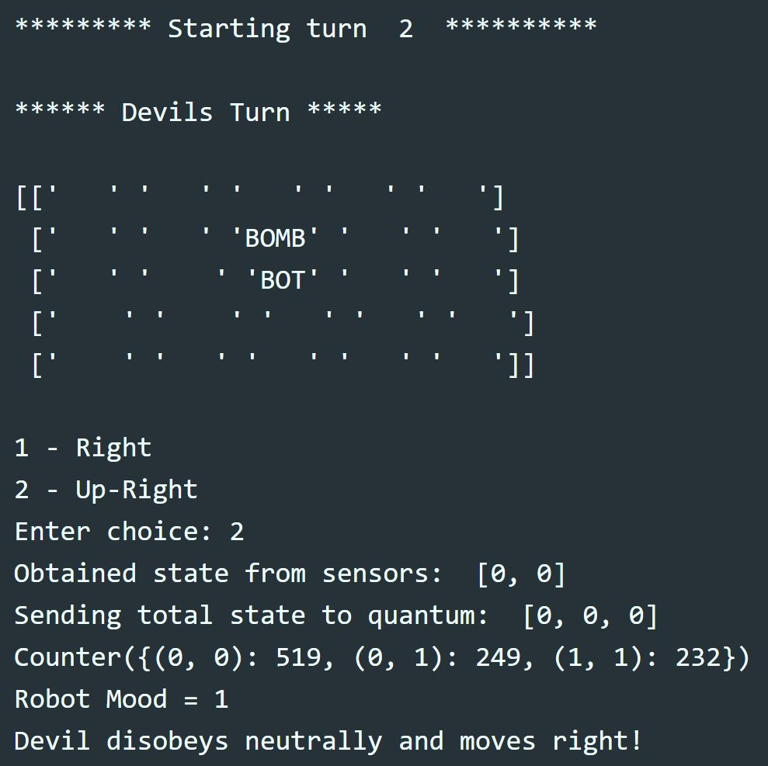
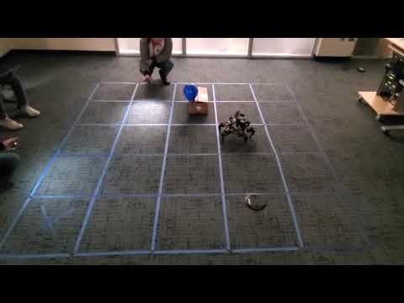

Move 3 - Devil Move/ Angel Wins

Slide 14
Demo 2 - Devil Wins
Notes:
Aron - talk through demo 2

Slide 15
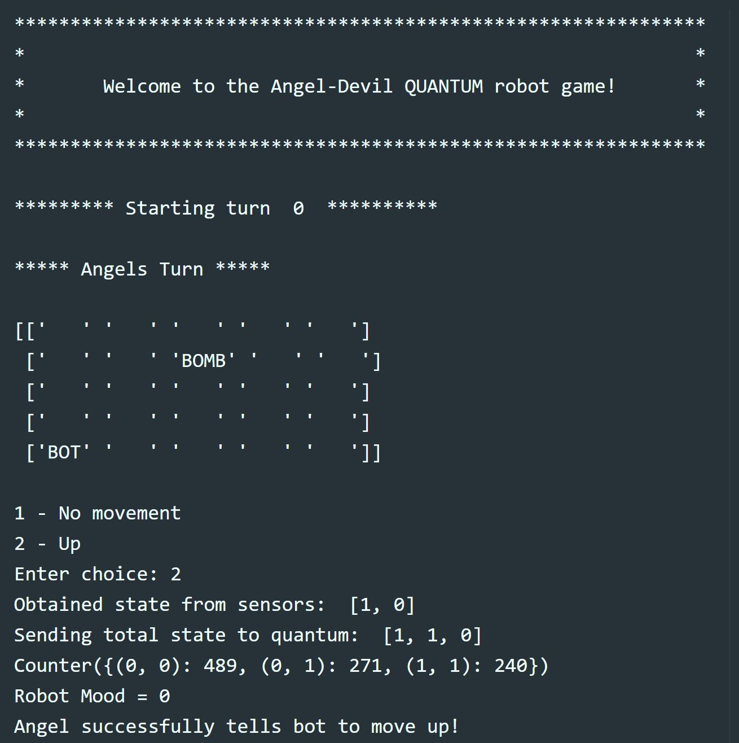
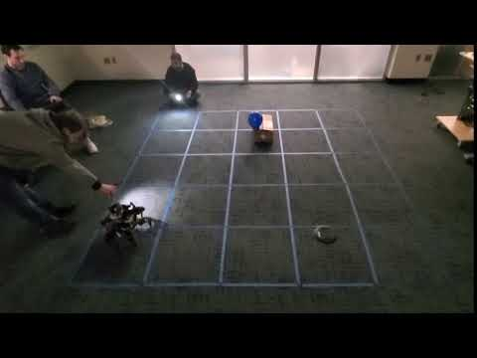
Move 1 - Angel Move

Slide 16
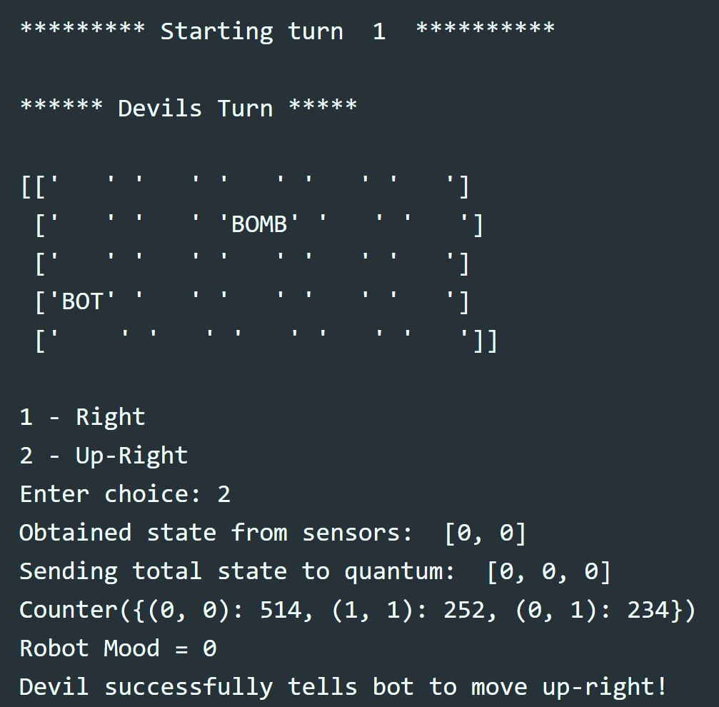
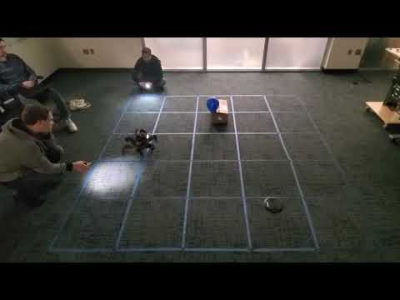
Move 2 - Devil Move

Slide 17
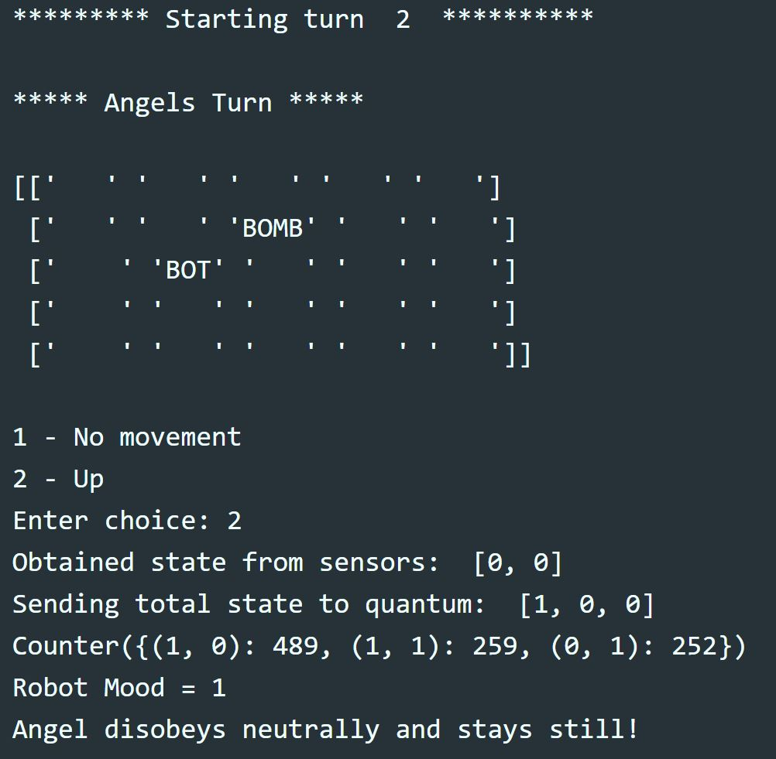
Move 3 - Angel Move

Slide 18
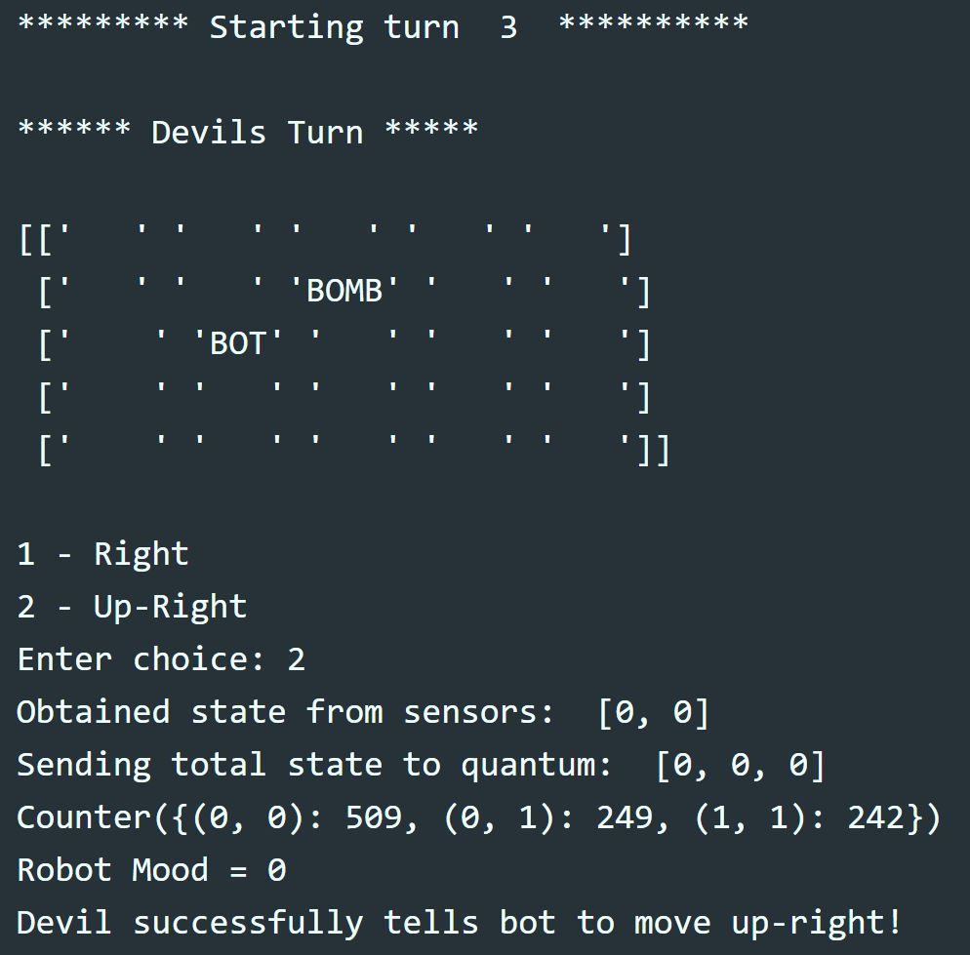
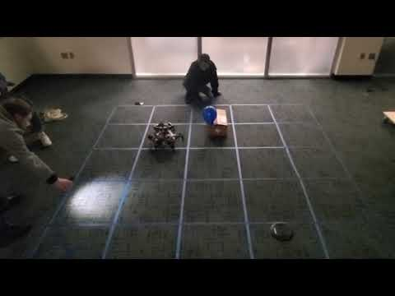

Move 4 - Devil Move/Devil Wins

Slide 19
Future Plans
Use OpenCV to “see” grid and align robot inside of each grid space
Use OpenCV to locate and pop balloon (raise/lower arm to align, etc)
Better integrate updated drivers
Add more gestures to the game
Update quantum circuit
Use light sensor instead of camera to determine brightness
Sound
Speech Recognition
Improve quantum circuit
Notes:
Tristan

